Slide 1
Smart Hydroponic Greenhouse
Project Plan
Embedded Systems
Bruno Silva – A88289
Rafael Pedro – A88271

Slide 2
Agenda
Problem Statement;
Problem Statement Analysis;
Market Research;
System Overview;
Requirements;
Constraints;
System Architecture;
Gantt Diagram.

Slide 3
Problem Statement
Climate change has emerged as one of the biggest environmental challenges of our planet;
International Energy Agency (IEA) estimates that CO2 emissions will increase by almost 5 % this year, being the biggest annual rise since 2010;
Food production contributes around 37 % of global greenhouse gas (GHG) emissions;
US Environmental Protection Agency (EPA) reported that 29 % of the greenhouse gas emissions in the USA come from transportation.

Slide 4
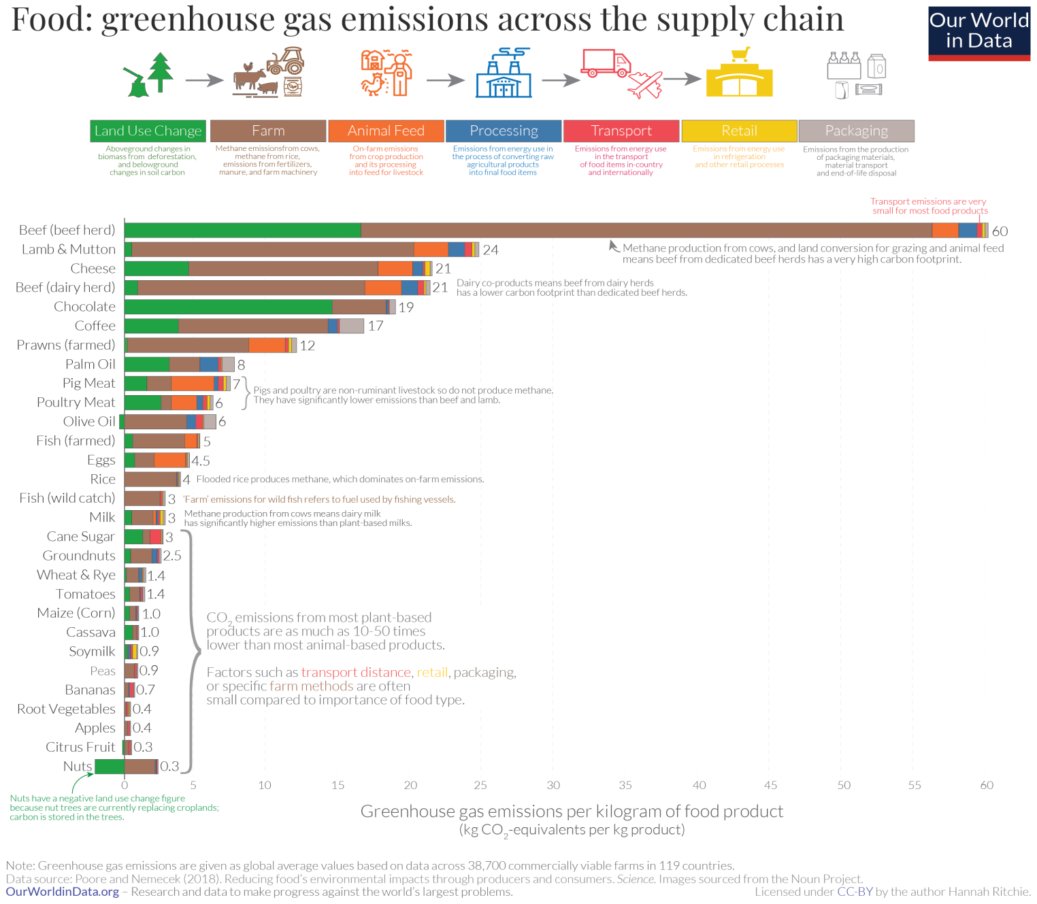
Problem Statement

Slide 5
Problem Statement
- Solution:
Increase the percentage of people that produce their food at home.
People would eat more plant-based food
Less demand for product transportation;
Reduced need for people to dislocate to a local grocery store.

Slide 6
Problem Statement
Smart Hydroponic Greenhouse:
Encourage people to join the hydroponic agricultural practice
Turn it into an easier activity;
Better results;
Less costs.

Slide 7
Problem Statement
Why hydroponics?
Occupies less space
Saves more water
No weeding necessary
Faster growing cycles
Less chemicals usage

Slide 8
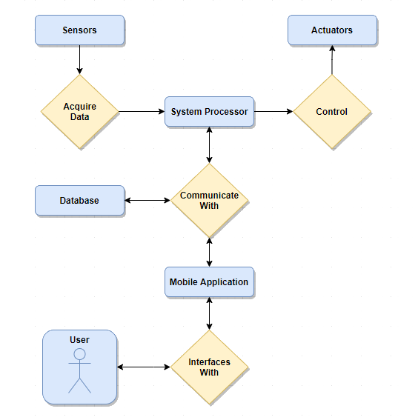
Problem Statement Analysis

Slide 9
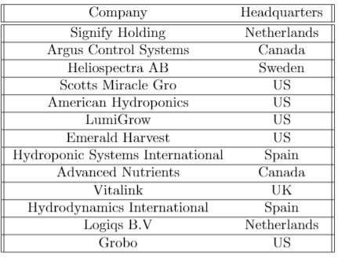
Market Research
Benchmarking
www.marketsandmarkets.com

Slide 10

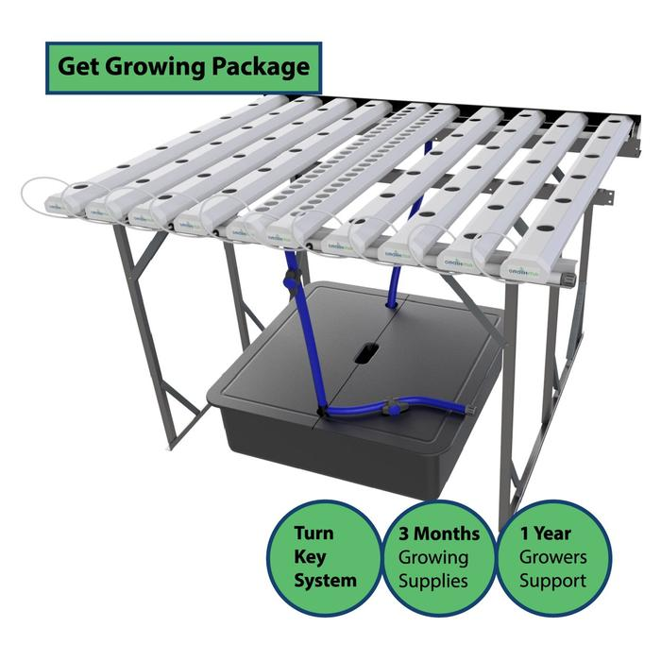
Market Research
1900$

Slide 11

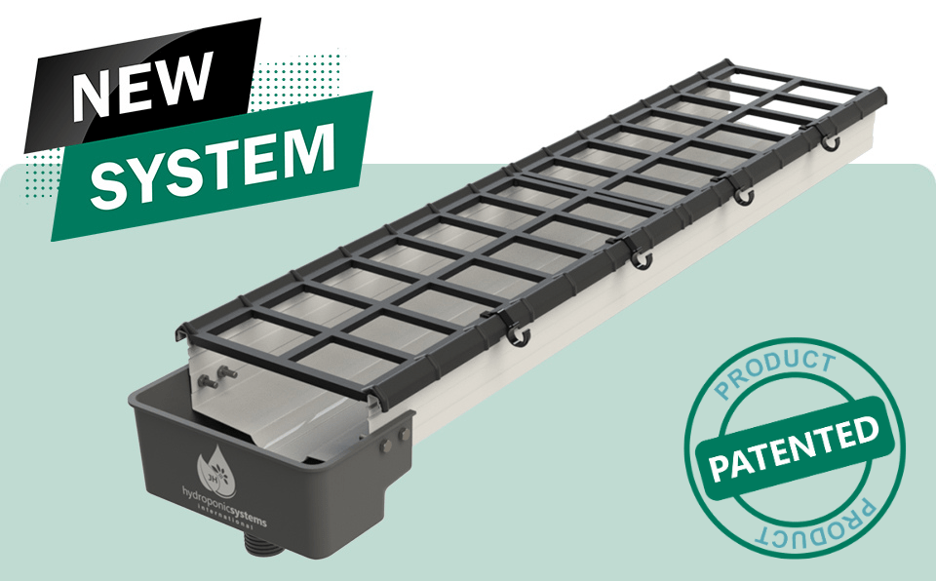
Market Research

Slide 12

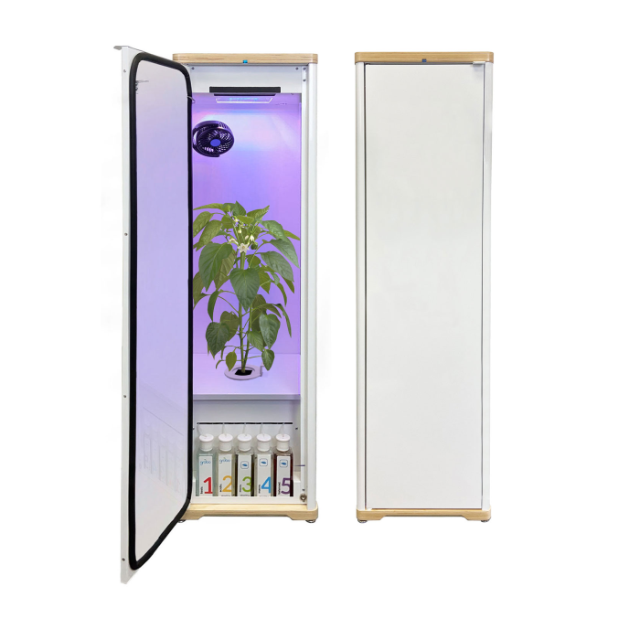
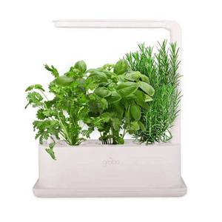
Market Research
1800$
80$

Slide 13

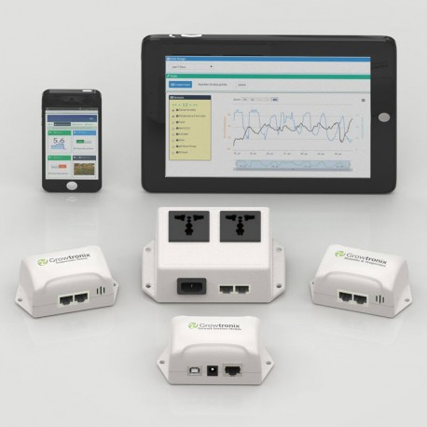
Market Research
1900$

Slide 14

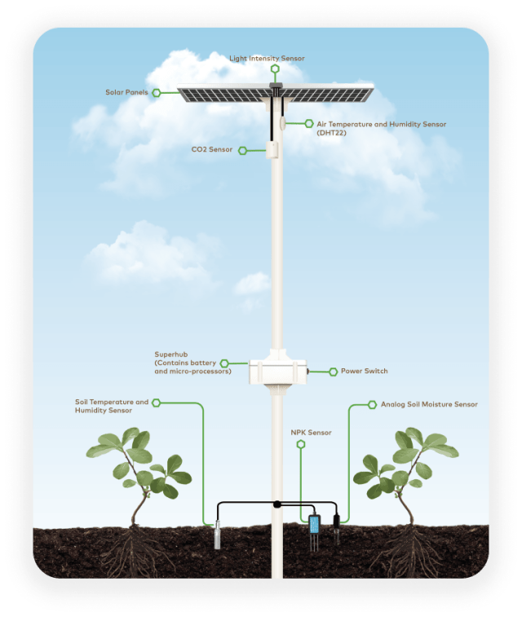
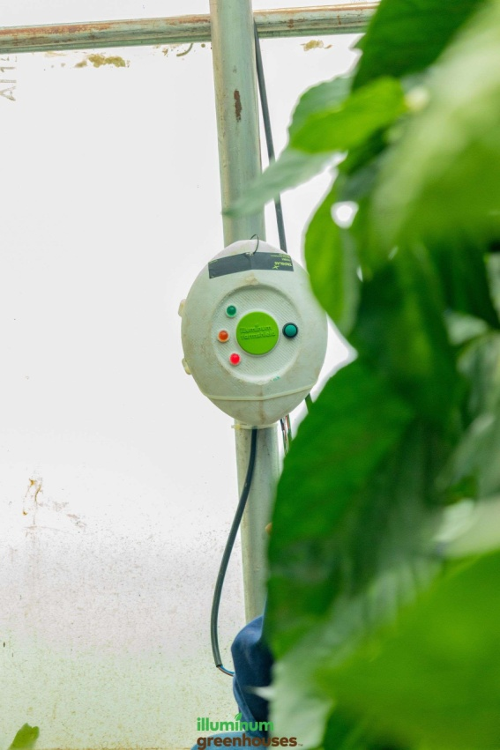
Market Research
FarmShield™

Slide 15

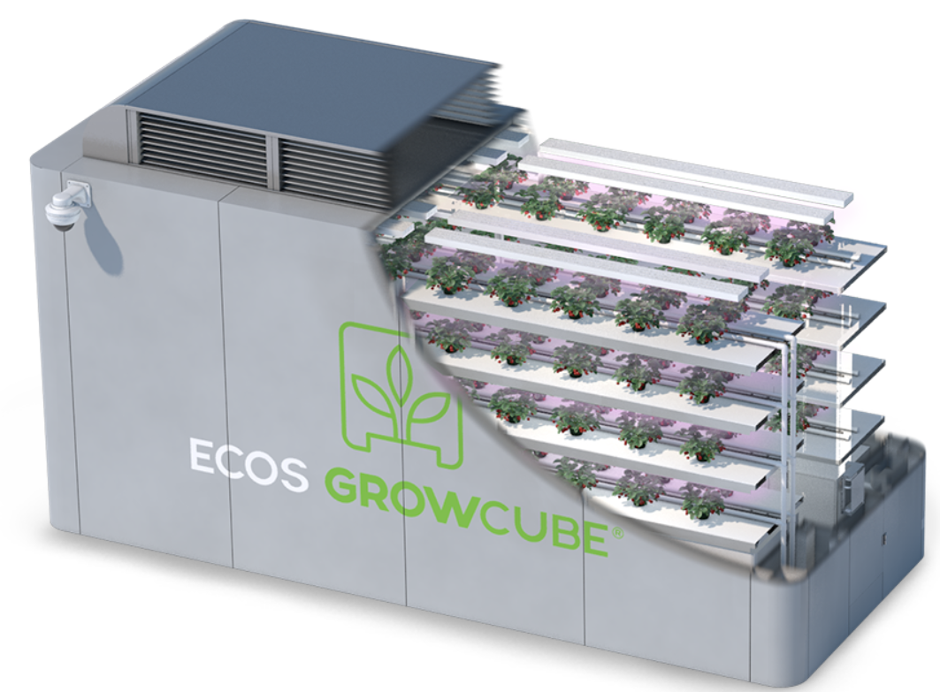
Market Research

Slide 16
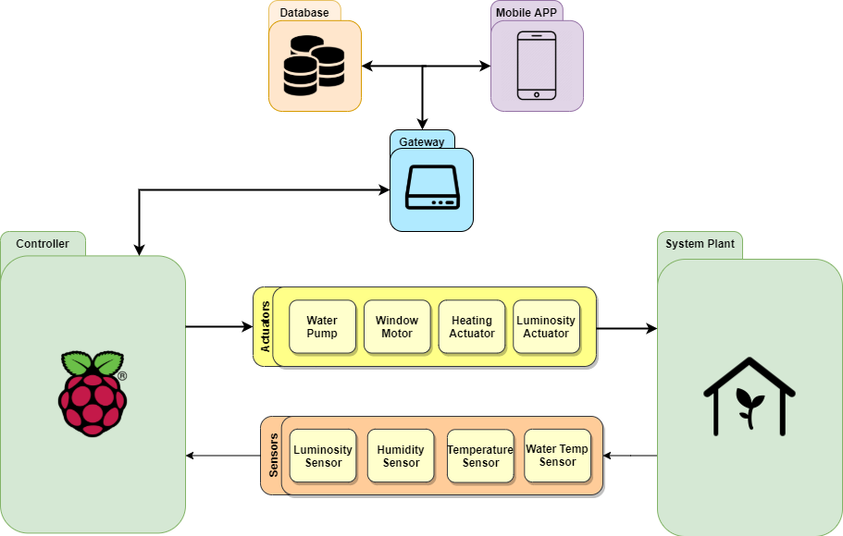
System Overview

Slide 17
Requeriments
Functional Requirements:
Control the temperature inside the greenhouse;
Control the light that the greenhouse gets per day;
Control the nutrient solution flow;
Measure the humidity inside the greenhouse;
Have an user interface application;
Non-Functional Requirements:
Sturdiness;
User-Friendly;
Low budget;

Slide 18
Constraints
Use Raspberry Pi in a Linux environment
Use Buildroot
Use Makefiles
Coded in C/C++
Implement Device Drivers
Implement a Cyber Physical System

Slide 19
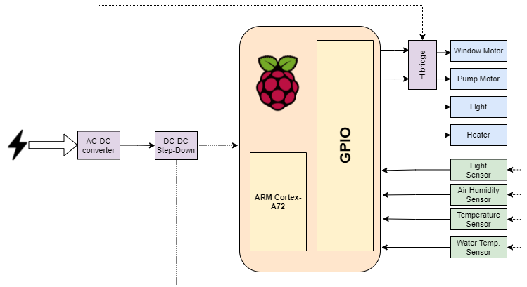
Hardware Architeture

Slide 20
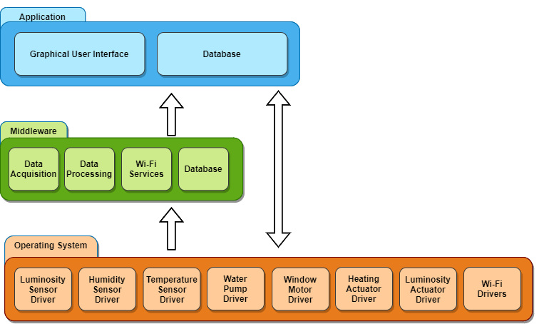
Software Architeture

Slide 21
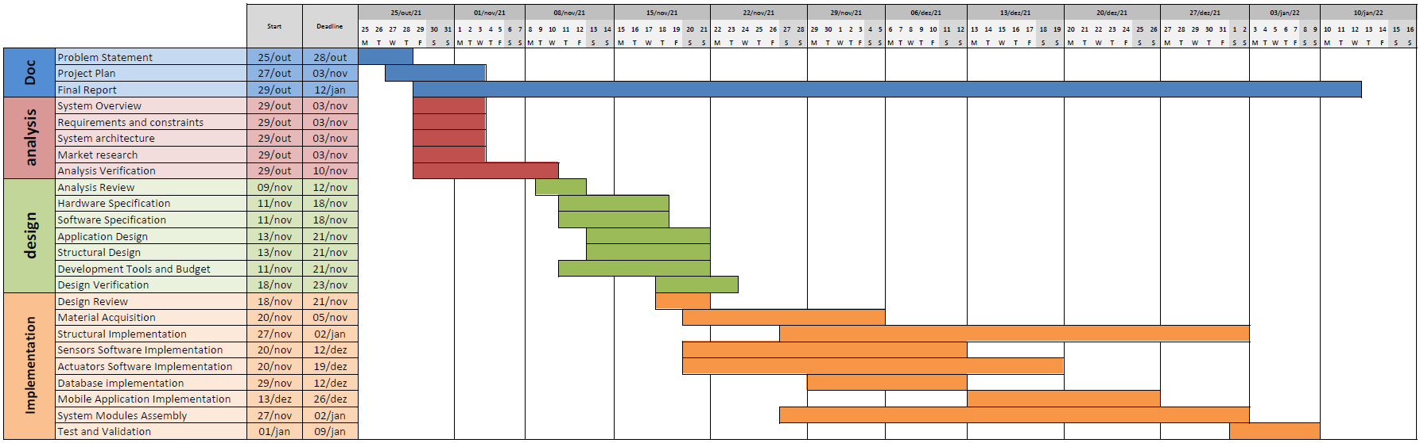
Gantt Diagram

